Slide 1
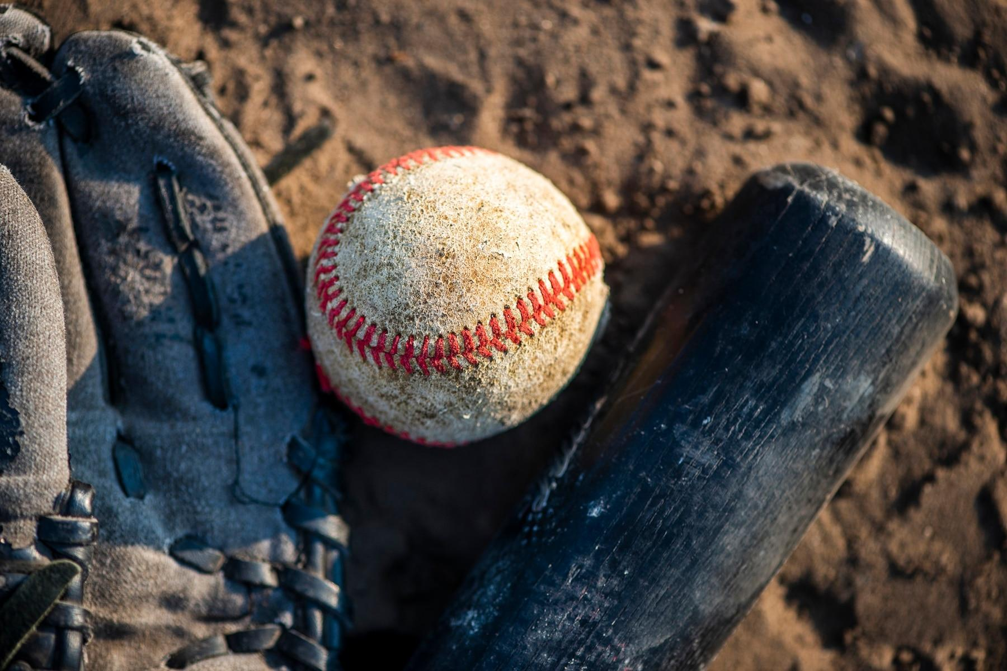
Moneyball: Part II
Members: Michael Garverick, Allen Alonso, Cole Turner, & Matthew Leon

Slide 2
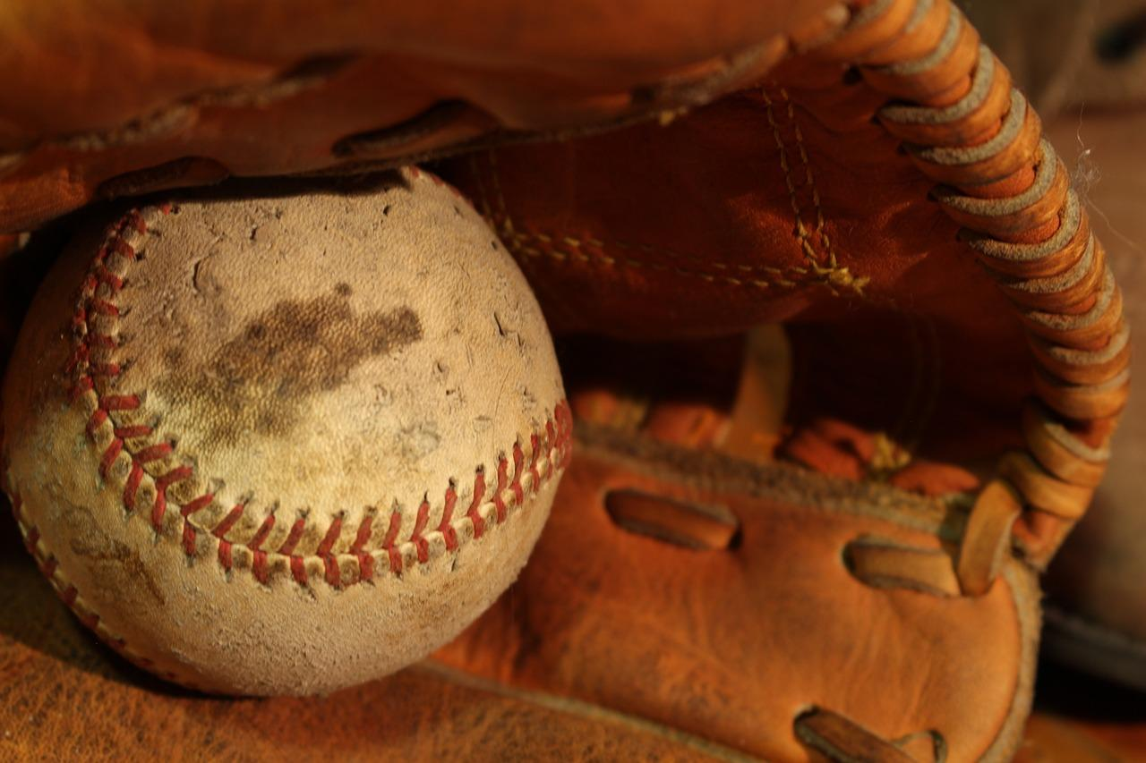
How different variables affected a team's batting average in the MLB from 2019-2021
How does location affect an MLB team’s batting average? (Average Temperature, Wind Speed, and Precipitation)
81 of the 162 games in a season are played at home throughout a season
Is there a home field advantage for players due to weather elements in that city?
Does the higher the team’s payroll equate to a higher team batting average?
There is no salary cap in Major League Baseball
Can money buy hits?
Does player age play a role in a teams batting average?
U.S. players must be minimum 18 years old
International players must be a minimum 17 years old
Is younger better? Or do you want veteran experience?
Notes:
Baseball is a very statistically-driven game that gives numerous options of how to “best” analyze the data. Businesses, organizations, books, and media have been created solely to show the “numbers-game” within the game, and to see what they can find in regards to patterns or similarities that have equated to success. We have taken on the project of specifically looking into Major League Baseball’s 30 teams’ Batting Averages, and trying to find out if there’s any correlation between higher or lower batting averages, and different variables that come into play during each game.

Slide 3
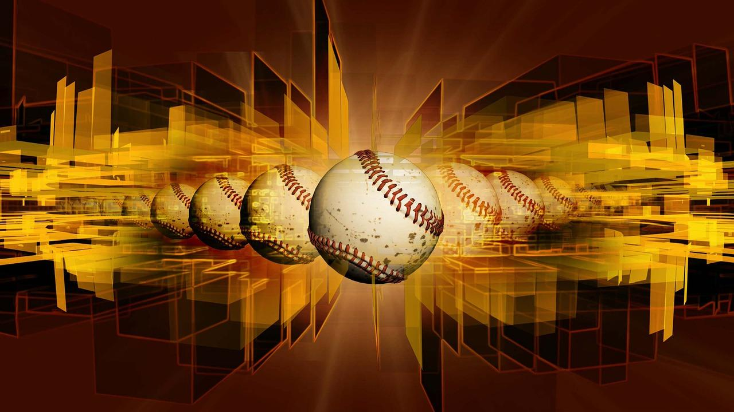
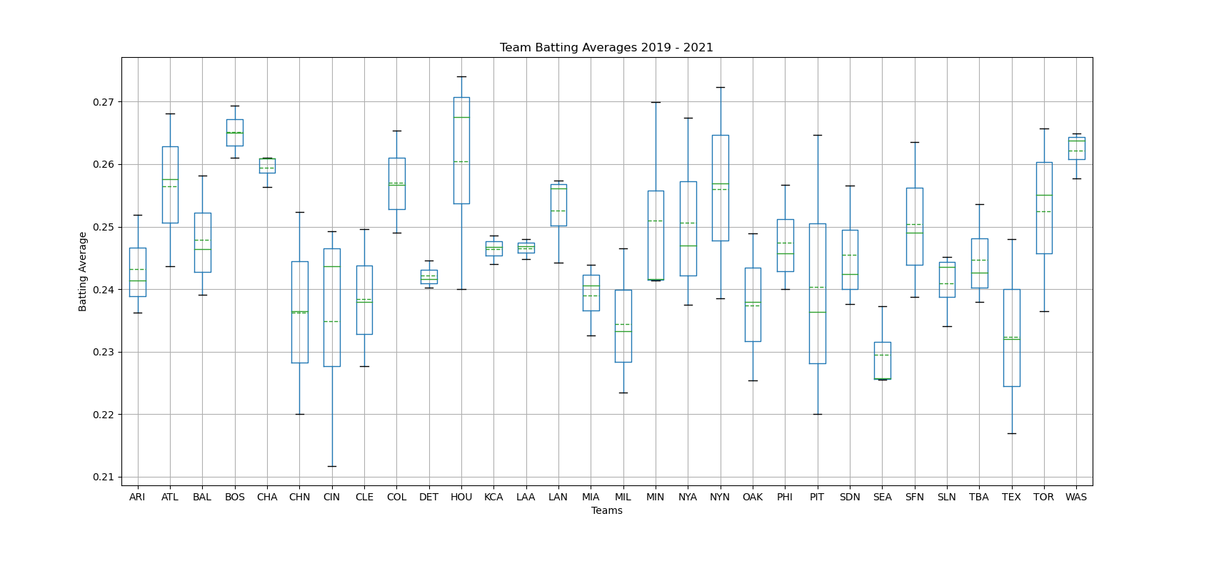
MLB Team Batting Averages 2019-2021
pvalue=0.0165592
Notes:
This slide displays MLB team batting averages from 2019-2021. Given that the P-Value is less than .05 there are variables that do affect batting average that we would like the explore. In our case those variables include team location, salary and age.

Slide 4
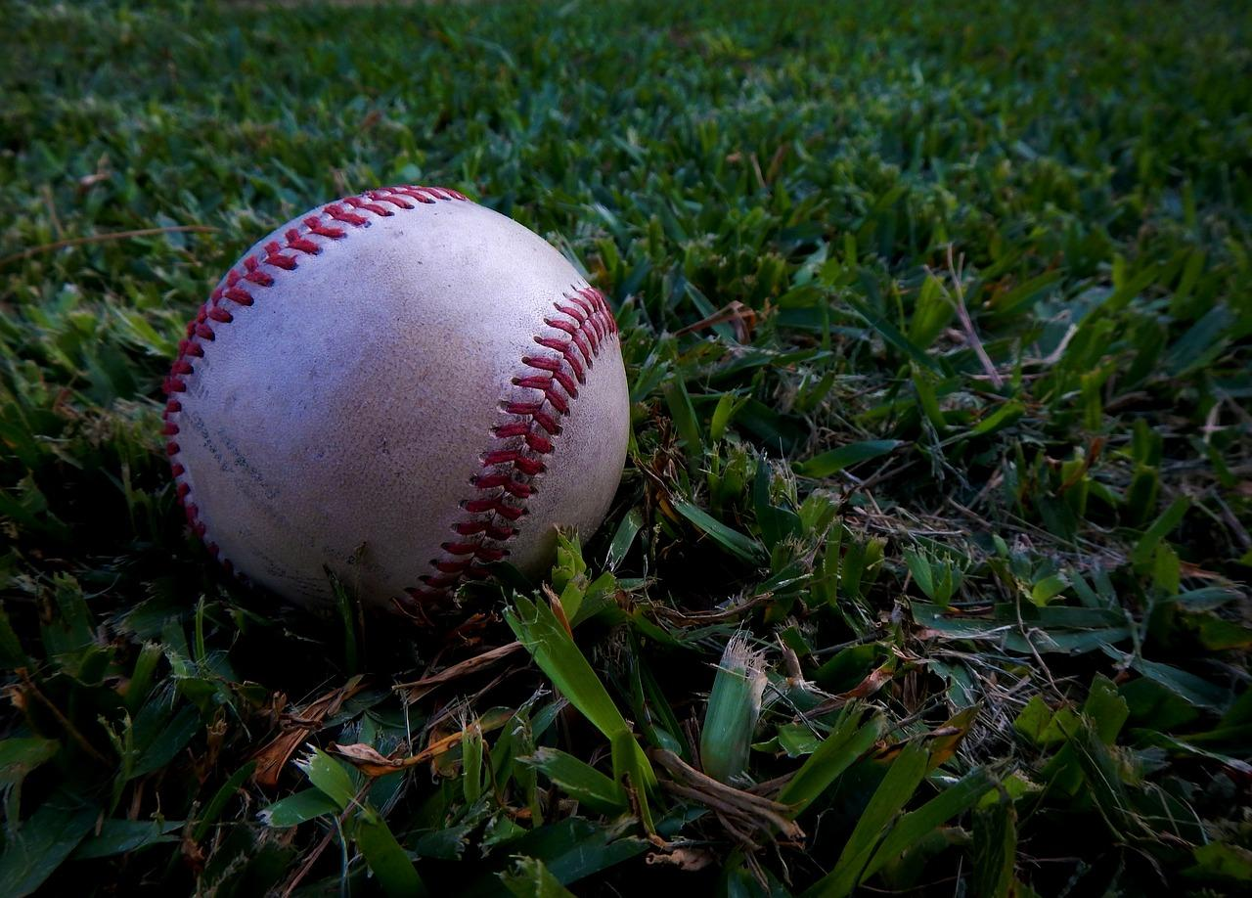
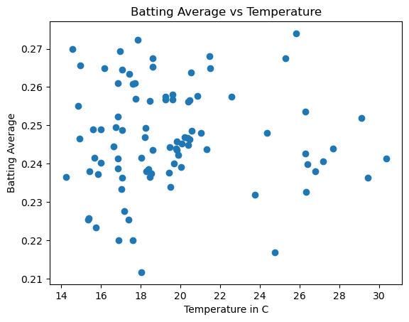
Checking Aspects of Weather Conditions
Temperature:
Does the team’s location temperature affect the batting average of a team?
The correlation coefficient between batting averages and temperature was 0
Notes:
Given each team’s relatively different location from each other, we were curious to know if the temperature in each team’s city played a part in a team’s overall batting average. Would it be easier or harder to hit in the 100+ degree heat of Arizona? Or easier or harder to hit the ball in a much colder environment such as Baltimore. Our data shows that there is no correlation between a city’s temperature and the team’s batting average.

Slide 5
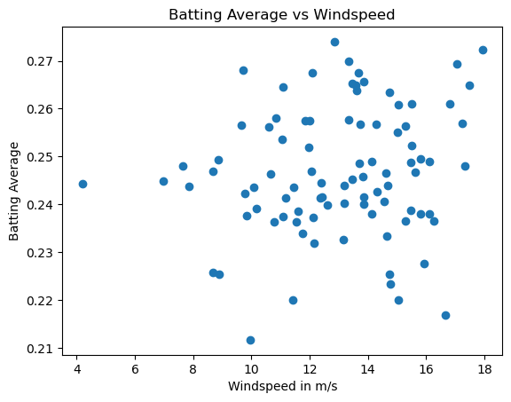
Checking Aspects of Weather Conditions
Wind Speed
Some correlation but not significant enough to support our hypothesis
The correlation was better than average temperature at 0.15 but still not enough for a conclusive deciding factor
Notes:
Another thought that we had was whether or not the average wind speed that a city deals with would affect a team’s batting average. Would the winds of the Windy City of Chicago cause a team’s batting average to go up or down depending on whether the wind was blowing in or out? Would the winds knock down deep fly balls and turn them into hits, or cause them to stay up in the air and turn a line drive into an out?

Slide 6
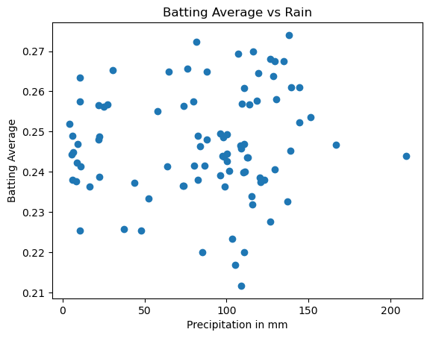
Checking Aspects of Weather Conditions
Precipitation
Rain is the most common form of precipitation that could affect a baseball game
It was not one of our original thoughts of being a factor that would affect batting averages due to multiple reasons:
Dome stadiums
Delayed/Suspended games
The correlation coefficient was 0.09
This supports the conclusion that precipitation plays no role in batting averages
Notes:
Rain was not going to be a major factor in batting average due to the fact that numerous teams have retractable domes that can close when there is inclement weather. When teams play in an open-air stadium, rain will typically cause either a rain delay, a suspended game until another date, or an outright early finish to the game which would not allow for higher or lower batting averages to occur.

Slide 7
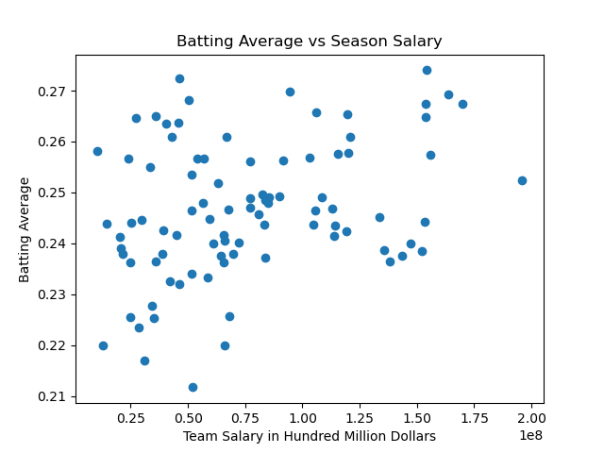
Average MLB Team Salary 2019-2021
Each team spends a different amount of money on players so we could expect teams with higher payrolls to have better hitters and so better batting averages
There does seem to be potential from this data to be positive correlated
There was a correlation coefficient of 0.33
Notes:
This slide displays the average MLB Team’s salary spent on players and how it correlates to higher or lower batting averages. We used a scatter plot to display this information because it gives the best representation of seeing what money can buy (see next slide for line). We see a positive correlation, and the correlation coefficient was .33

Slide 8
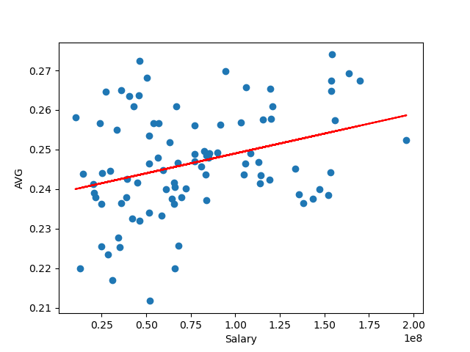
Average MLB Team Salary 2019-2021
Better players require more money so the teams that spend the most money are the ones you would expect to have the best statistics.
This is not always the case there are a number of factors such as injuries, great rookie hitters and also money being spent on pitchers
This can be seen in some of the outliers as it is not always the case that salary results directly in the best batting average.
Notes:
Why is there a correlation between payroll and batting average? One reason could be that to have the best, you need to buy the best. Better players require more money. Another interesting factor are stand-out rookie hitters that tear the cover off the ball and hit for a very high average throughout the season, which would make for one of the possible outliers if they’re in the beginning of a rookie contract (normally nowhere near as high as a older, veteran’s salary).

Slide 9
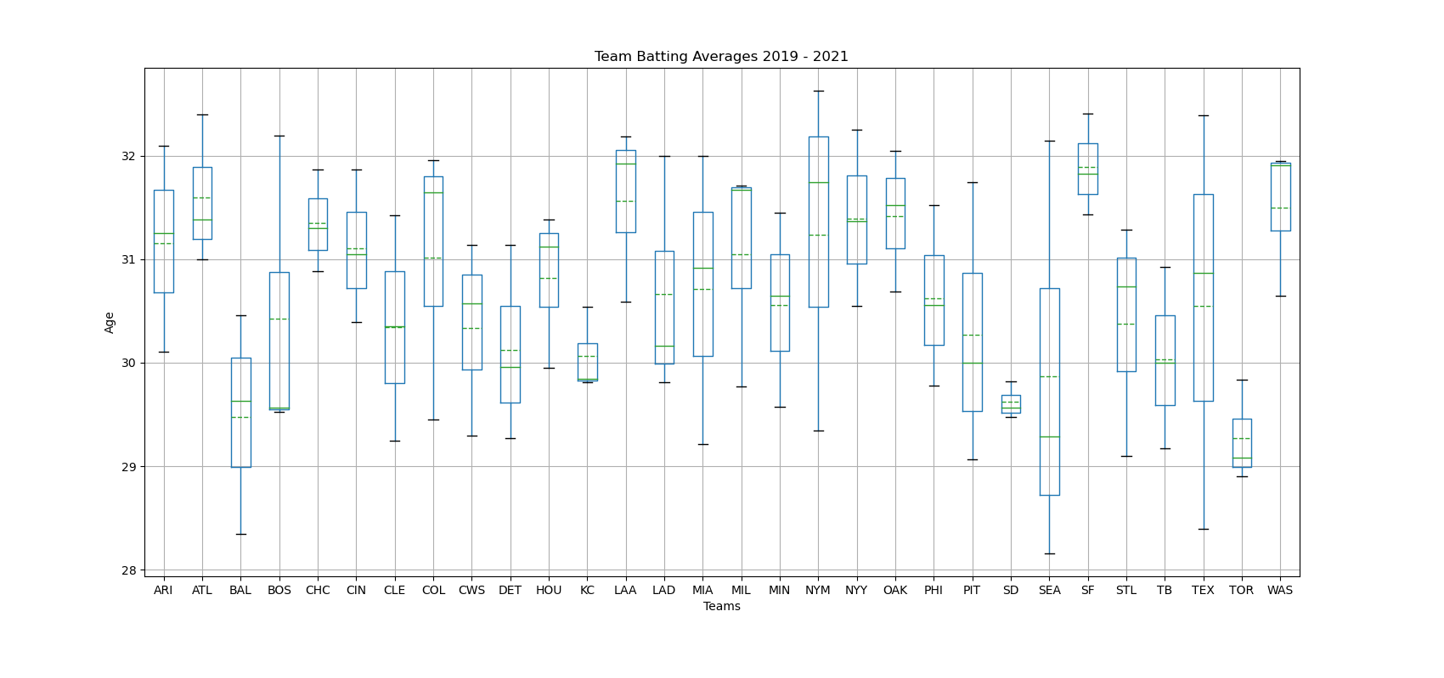
Average Age Per MLB Team
Notes:
As salaries increase and signing bonuses get higher and higher, teams are trying to build for the future and keep a player for a long as possible; meaning they sign them as early as possible. We are curious to know if a team’s average age has anything to do with batting average. Do the young bucks have the speed to beat out the infield hits? Or do the older veterans abide by the old saying, “hit em where they ain’t” and manage to bloop texas-leaguers over the head of the 2nd baseman time after time.

Slide 10
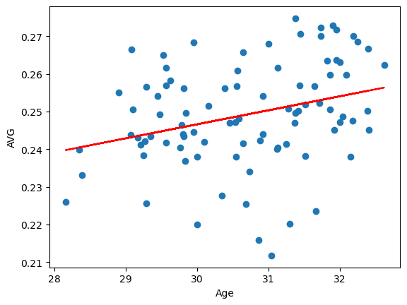
Average Player Age Per MLB Team vs Batting Average
A decent correlation was found for this graph with a coefficient of 0.299, showing older players have higher batting average
This could be because teams are keeping players in the Minor Leagues longer or bringing in from International Leagues
Notes:
Here we see the line going up and to the right; showing that there appears to be a bit of a correlation between the older a team’s average age is, the higher the batting average tends to be. Players are not sent straight to the Majors anymore, and teams are keeping star players in the Minor Leagues for longer than they have before; this could be a reason for the correlation. The MLB is also seeing an increase in players leaving different International Leagues and coming to America to play in the MLB at an older start age.

Slide 11
Conclusion
How does location affect an MLB team’s batting average? (Average Temperature, Wind Speed, and Altitude)
Based on the data pulled, Wind Speed shows the highest effect on MLB team’s batting averages when it comes to weather conditions. However it still has a weak to non-existent correlation.
Does the higher the team’s payroll equate to a higher team batting average?
Teams with a higher payroll do tend to have a higher batting average.
Does player age play a role in a teams batting average?
Teams with an older player age average had a higher batting average.
Out of all the data collected, The most relevant data pulled was the MLB team’s payroll information with a correlation coefficient of 0.33 (All correlations were done with the pearson r).
Notes:
Just to recap, Wind Speed shows the highest effect on MLB team’s batting averages when it comes to weather conditions. However it still has a weak to non-existent correlation. Then, Teams with a higher payroll do tend to have a higher batting average..Teams with an older player age average had a higher batting average. In conclusion, The most relevant data pulled was the MLB team’s payroll information with a correlation coefficient of 0.33.

Slide 12
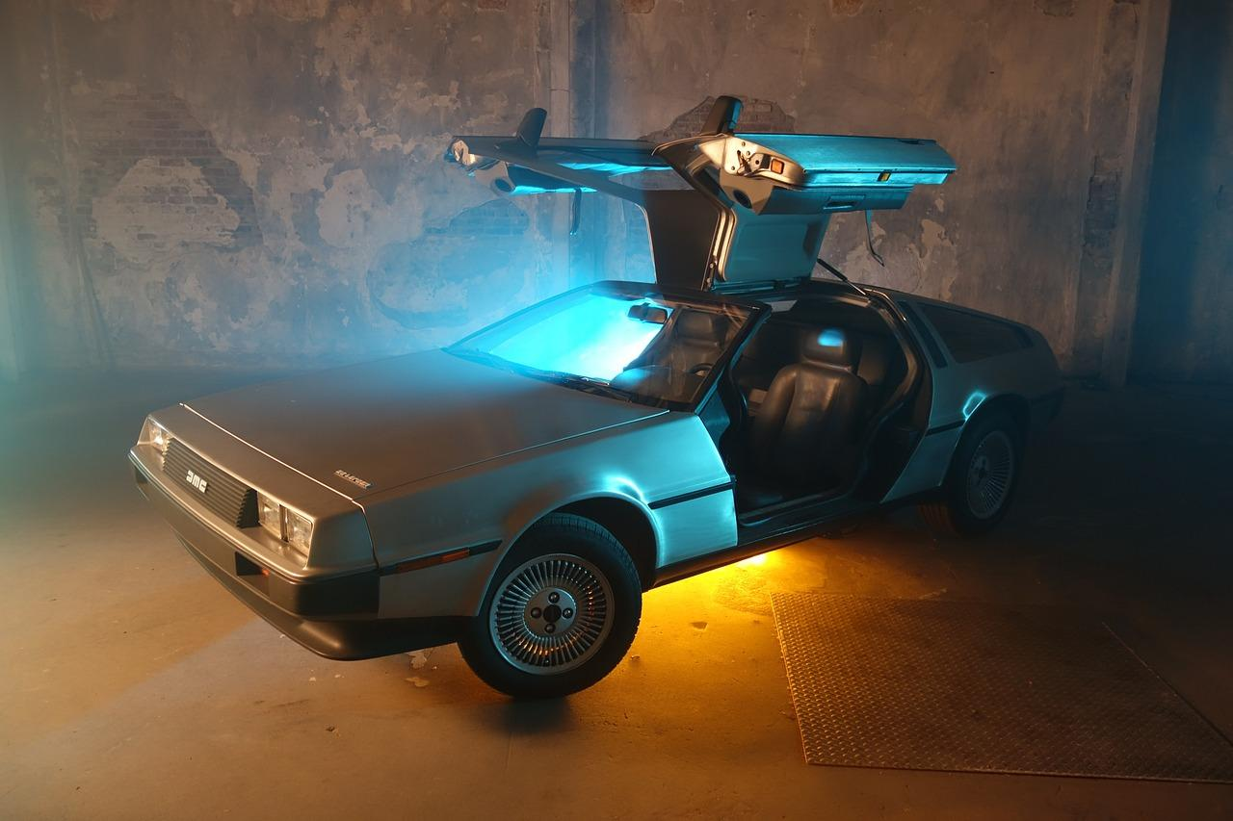
Part III: In the Future…?
After concluding that there was a variable affecting teams’ batting average, we took a look at a few of the major factors we thought were most likely responsible.
In the future, we would be very interested in continuing our research and looking further into the following possibilities:
Pitching Statistics (do teams have a higher batting average facing a Right-Handed Pitcher or Left-Handed Pitcher?)
Ballpark Environment (Open-Air vs. Domed Stadiums)
Time of Day (Are batting averages higher during day games or night games)
Notes:
As we stated in the introduction of our presentation, baseball is filled with plenty of options when it comes to finding and analyzing data. If we were to continue our project and build upon it to go deeper, here are a few other items we would like to spend time on researching to give a more in-depth comparisons of batting average.We would like to look at pitching stats to see right handed pitchers have an edge on left handed pitchers. Then to look at more ballpark environment variables, maybe open-air vs domed stadiums and then Time of Day, how batting averages could be different based on day vs night games.

Slide 13
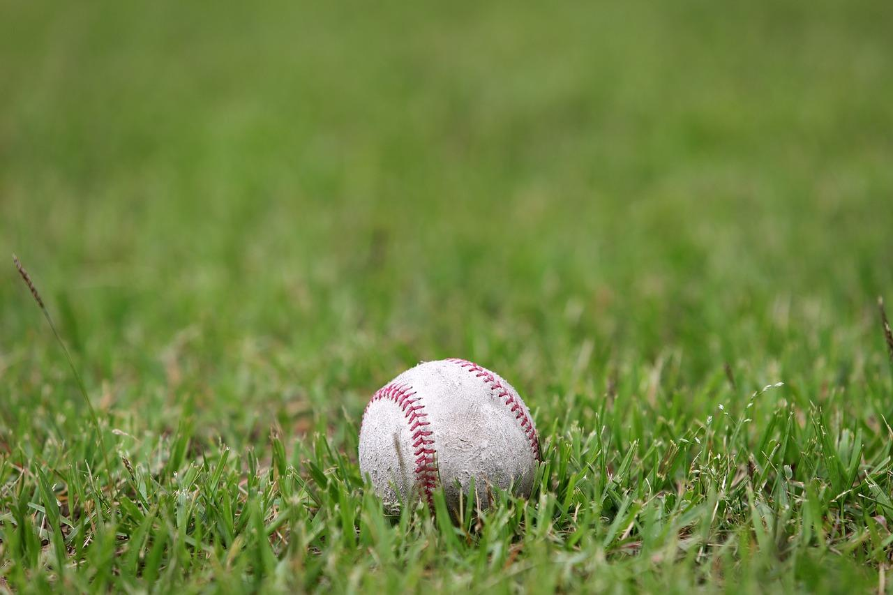
Data References
Baseball batting Averages (.csv file): baseballdatabank/core at master · chadwickbureau/baseballdatabank (github.com)
Baseball stadium locations (.json file): https://gist.github.com/the55/2155142
Weather Library: https://github.com/meteostat/meteostat-python
MLB Player Ages per team: 2023 MLB Player Stats (rotowire.com)
Notes:
Lastly displayed are our data sources. We limited the years from 2019 to 2021 to keep our information consistent with payroll data available from the MLB as well as weather data.

